Slide 1
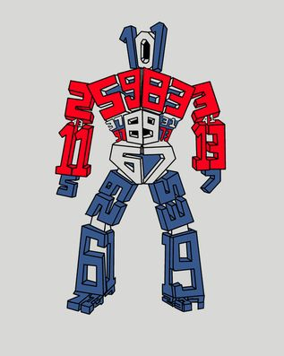
Prime Factorisation
EQ – How do I write numbers as a product of prime factors?
OPTIMUS PRIME NUMBER

Slide 2
QUICKWRITE
On the LHS
What are Prime numbers and list as many prime numbers you can

Slide 3
24
7
30
Date
Prime Factorisation
EQ – How do I write numbers as a product of prime factors?

Slide 4
24
7
30
Date
Prime Factorisation
EQ – How do I write numbers as a product of prime factors?
How do I find the prime factors?
Use a factor tree to write 540 as a product of prime factors.
Find 2 numbers x to give 540
540

Slide 5
24
7
30
Date
Prime Factorisation
EQ – How do I write numbers as a product of prime factors?
How do I find the prime factors?
Use a factor tree to write 540 as a product of prime factors.
Find 2 numbers x to give 540
540
Circle any primes
prime
2
270

Slide 6
24
7
30
Date
Prime Factorisation
EQ – How do I write numbers as a product of prime factors?
How do I find the prime factors?
Use a factor tree to write 540 as a product of prime factors.
Find 2 numbers x to give 540
540
Circle any primes
prime
2
270
Continue dividing until all factors are prime
prime
2
135

Slide 7
24
7
30
Date
Prime Factorisation
EQ – How do I write numbers as a product of prime factors?
How do I find the prime factors?
Use a factor tree to write 540 as a product of prime factors.
Find 2 numbers x to give 540
540
Circle any primes
prime
2
270
Continue dividing until all factors are prime
prime
2
135
27
5
prime

Slide 8
24
7
30
Date
Prime Factorisation
EQ – How do I write numbers as a product of prime factors?
How do I find the prime factors?
Use a factor tree to write 540 as a product of prime factors.
Find 2 numbers x to give 540
540
Circle any primes
prime
2
270
Continue dividing until all factors are prime
prime
2
135
27
5
prime
prime
3
9

Slide 9
24
7
30
Date
Prime Factorisation
EQ – How do I write numbers as a product of prime factors?
How do I find the prime factors?
Use a factor tree to write 540 as a product of prime factors.
Find 2 numbers x to give 540
540
Circle any primes
prime
2
270
Continue dividing until all factors are prime
prime
2
135
27
5
prime
prime
3
9
prime
3
3
prime

Slide 10
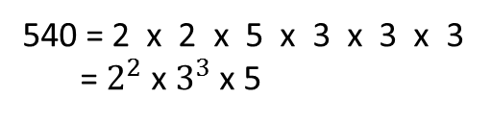
24
7
30
Date
Prime Factorisation
EQ – How do I write numbers as a product of prime factors?
How do I find the prime factors?
Use a factor tree to write 540 as a product of prime factors.
Find 2 numbers x to give 540
540
Circle any primes
prime
2
270
Continue dividing until all factors are prime
prime
2
135
27
5
prime
prime
3
9
Write the primes in ascending order
prime
3
3
prime
540 = 2 x 2 x 5 x 3 x 3 x 3
= $2^{2}$ x $3^{3}$ x 5

Slide 11
Task
Let’s work through another example together.
Write 84 as a product of prime factors

Slide 12
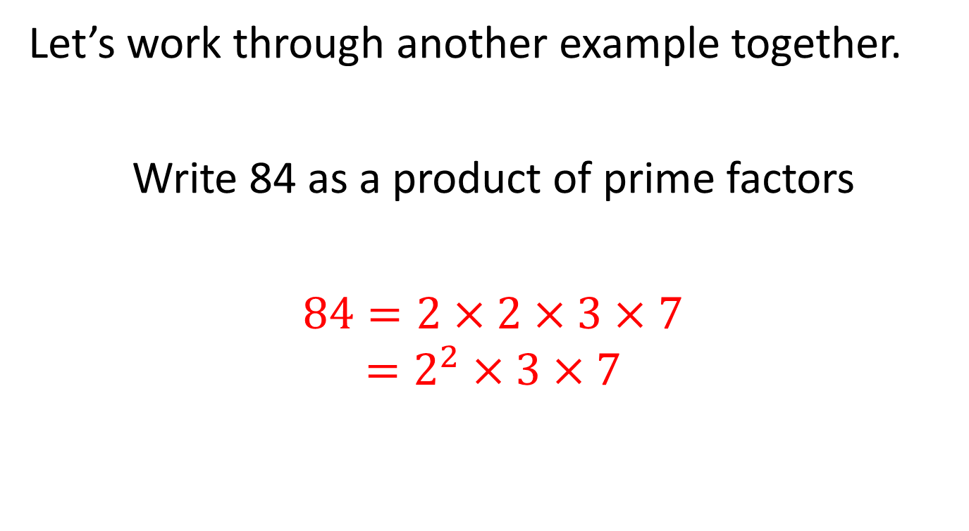
Task
Let’s work through another example together.
Write 84 as a product of prime factors
$84=2×2×3×7$
$$=2^{2}×3×7$$

Slide 13
Task
Nelson textbook page 82 question 7 - 9

Slide 14
Notes Review
24, 7 ,30
Date
Title
Essential question
Notes complete
Notes complete with colour and diagrams
Questions completed
Contents page filed in
Formula page filled in

Slide 15
Homework
Review your notes and write a summary answering the essential question.

